Slide 1
Renewable Energy
September 13, 2011
Sunil Mandhan

Slide 2
Agenda
Background
Benefits
Applications
Impediments
Global Statistics
GE Initiatives
India Growth Story
Future
Q & A

Slide 3
What is Renewable Energy
According to IEA:
“It is derived from natural processes replenishing constantly.
In its various forms, it derives directly from the sun, from heat deep within the earth, electricity and heat generated from solar, wind, ocean, hydropower, biomass, geothermal resources, and biofuels and hydrogen derived from renewable resources.”

Slide 4


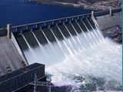
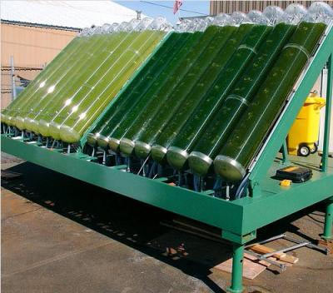
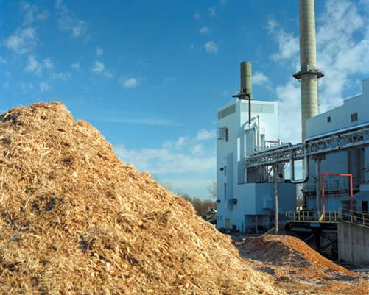

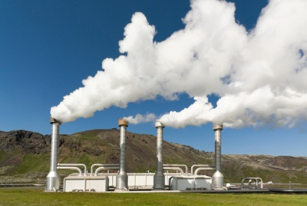

Various forms of Renewable Energy
Solar (Thermal & PV)
Wind
Hydro
Biofuel (Ethanol)
Biomass
Hydrogen
Geothermal
Ocean/Tidal waves
1
2
3
5
6
4
7
7
8

Slide 5
Why Renewable Energy?
Environment Benefits
Cleaner Energy
Helpful to curb Global Warming
Energy Security
Constantly replenished
Alternative source of energy needs.
Economical Impact
Its free after initial setup cost.
Fast social and economical growth.

Slide 6
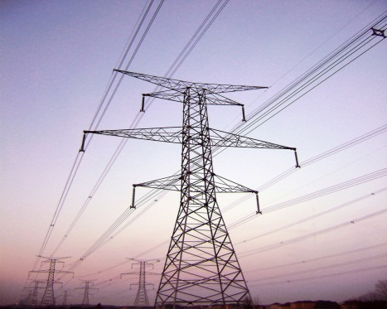

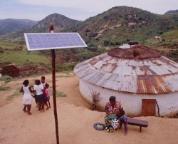

Applications
Sectors:
Power
Transport (biodiesel, ethanol)
Heat/Cooling
Rural/Remote Areas
Model Cities:
Nagpur, India
Tokyo, Japan
1
2
4
3

Slide 7
Impediments, no widespread use?
Higher investment cost & ROI is around 10-15+ years.
Variation in environment & output, backup needed.
Big area required for installation of Solar & Wind farms.
Not in my back yard (NIMBY).
Competition from technologies like Nuclear Energy.
Less social awareness.
Cost effective means & social awareness required.

Slide 8
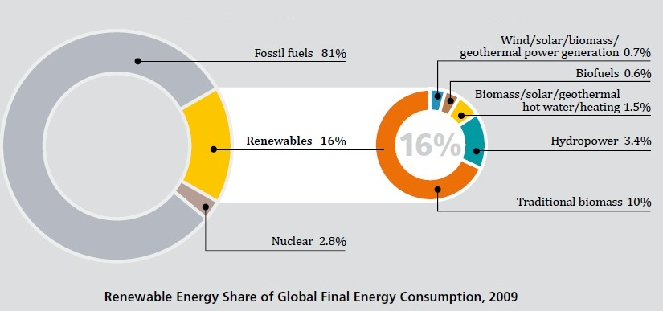
World Energy Consumption Scenario
Renewables need more push to replace fossil fuels.

Slide 9
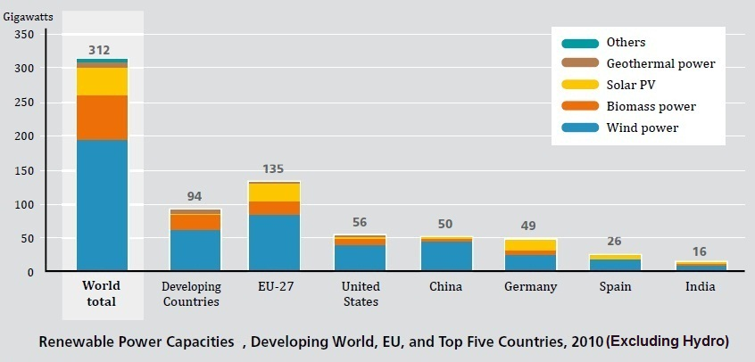
World Installed Capacities
Not a key player
India, a huge & energy hungry country lags in capacity.

Slide 10
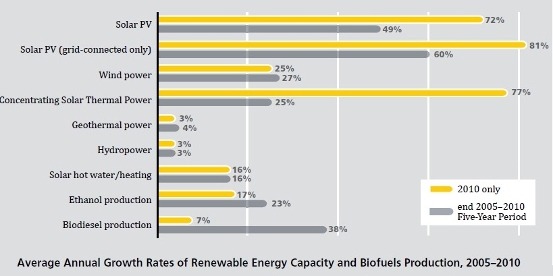
Renewables Growth Rates
Rapid growth in all the Renewable Sectors.

Slide 11
GE Initiatives
Wind
~17K GE turbines world wide (~99% availability, 27 GW)
Solar
Panels up to 150 W & Inverters up to 1 MW output.
CdTe thin film panel ~13% efficiency.
Building World’s largest solar panel factory (400 MW).
Wattstation – Charging Electric Vehicles (EV).
FlexEfficiency – Combined cycle power plant
GE is geared and committed to take the future challenges.

Slide 12
India Growth Story
In 2008, ~18% global population & ~4% energy consumption.
Currently, ~10% (84 TWh) deficit in demand and production.
Plans from 2007-12
78.7 GW renewable capacity to be added
Wind: 10.5 GW added, Small hydro: 1.4 GW
Biomass : 1.7 GW added
Plans By 2022
Solar Thermal: 14 GW, Solar PV: 12 GW
Rural lighting: 20 million homes

Slide 13
Future Prospects
Electricity demands will be ~2X in 2030.
Population will be ~8 Billion in 2030.
Energy security will be the focus as the prices of fuels are increasing and depletion continues.
More and more countries will have renewables commitment. Currently 85 are adapting policy changes.
Plan for 100% Energy need from Renewables by 2030.
Renewables as alternative energy source for increasing demands.

Slide 14
Q & A Discussion

Slide 15
Appendix
IEA: International Energy Agency
GW: Giga Watt
MW: Mega Watt
PV: Photo Voltaic
CdTe: Cadmium telluride
TWh = 144 MW

Slide 16
Reference
http://www.bp.com (Statistical Review of World Energy, 2011)
http://www.ren21.net (GSR 2011, India Renewables Report 2010)
http://en.wikipedia.org/wiki/Renewable_energy
http://www.iea.org/textbase/nppdf/free/2009/cities2009.pdf
http://www.ge-energy.com/products_and_services/
http://www.ge.com/investors/events/event_id05112011.html (Vic Abate)
http://nensol.com/products.html
http://www.squidoo.com/solarseeds
http://www.treehugger.com/files/2008/03/15-algae-biofuels-energy.php

